Slide 1
K-5 Innovation Spaces
2013-14

Slide 2
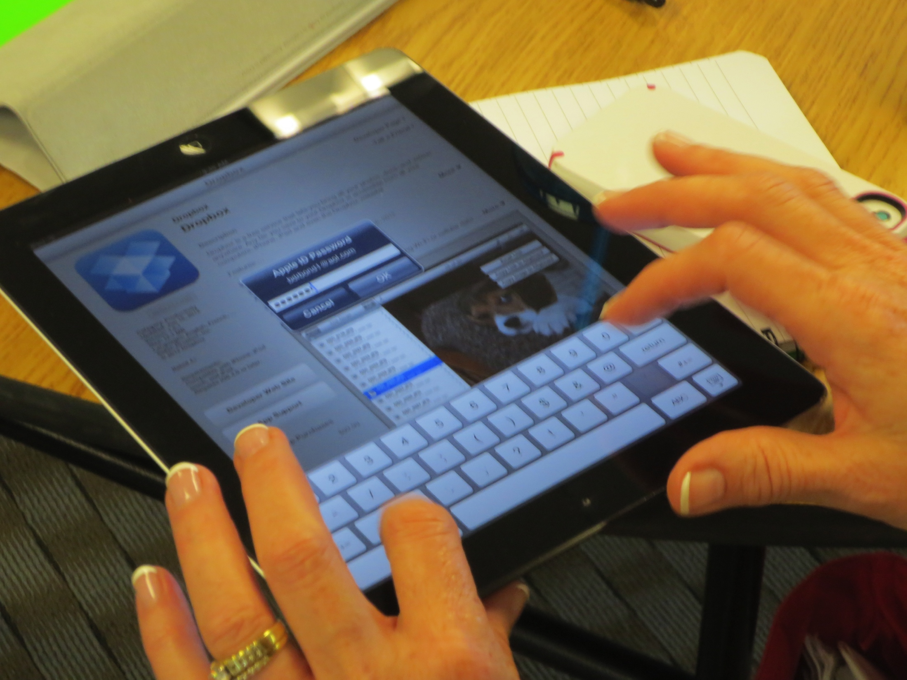
Purpose:
To identify, support and provide classroom teachers and students with technology-rich innovation spaces where the technology is seamlessly integrated into teaching and learning.

Slide 3
K-5 Innovation Spaces:
The K-5 Technology Innovation Spaces project has been expanded for the 2013-14 school year to include classrooms in the following buildings.
Blue River Elementary | Cedar Hills Elementary
Harmony Elementary | Liberty View Elementary
Mission Trails Elementary | Oak Hill Elementary
Stilwell Elementary | Sunrise Point Elementary

Slide 4
K-5 Innovation Spaces:
Create technology-rich classrooms where teachers demonstrate technology instructional strategies using an array of devices.
Technology focused on student applications and implementation.
Instructional strategies and framework will be inclusive of technology tools and resources.
Professional development provided using a variety of delivery methods.

Slide 5
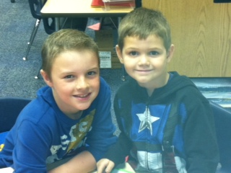
Classroom Technologies:
Dual touch SMARTboard
ELMO Document Camera
DEWEY iPad stands
Wi-Pad iPad Receivers
Netbooks
iPads with instructional apps
Web-based resources
Virtual Clickers

Slide 6
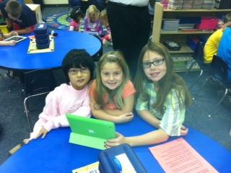
Additional information about the program can be found at:
http://www.bluevalleyk12.org/innovationspaces

